Slide 1
Quality Assurance and Quality Control of Stable Isotope Measurements
Your results will only be as good as your data quality.
You are responsible for calculating and testing data quality for your study.

Slide 2
Defining QA/QC
Quality Assurance – Framework for establishing quality control procedures and verifying data quality.
Quality Assurance Plans
Standard Operating Procedures
Independent Testing
Audits and Reviews
Quality Control – System of procedures, processes and measurements to control and document the data quality.
Implementing of Procedures (i.e. calibration)
Use of Replicates and Standards

Slide 3
QA/QC should answer the following questions:
How well is the machine running, including the calibration process?
How variable are my samples (variation within a sample)?
Have my samples been unintentionally fractionated since collection?
How variable are my populations of interest?
Can I tell the difference between populations that I would like to?

Slide 4
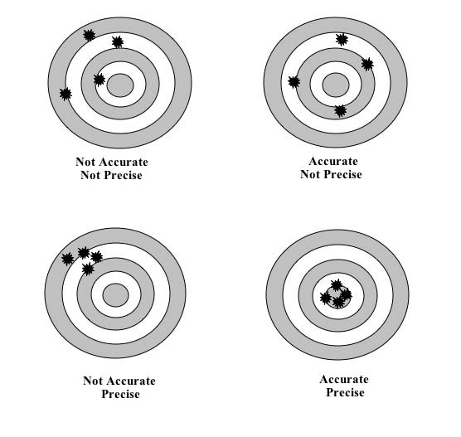
Measures of Uncertainty

Slide 5
Accuracy “Better to be imprecisely accurate than precisely inaccurate.”
Nearness of a measured value to the actual value.
measured value – actual value
Determines significant digits for reporting
Evaluated with standards with known values
Determined from QC standards (not ones used for calibration, more later).
Identical Treatment Principle: Standards must be treated as samples.

Slide 6
Precision How variable are my samples?
Standard deviation of repeated measures of a sample. NOT STANDARD ERROR!
Standard Deviation: describes variation within a population.
Standard Error: describes error around a estimated mean and is dependent on sample size.
Coefficient of Variation
Std. dev / sample mean
Useful for comparing precision for measurements with different unit scales (i.e. 1-10 vs, 1000-10,000)
Not to be used with ratio numbers (i.e δ units) zero doesn’t mean no value in δ units. (use F or Atom %).
Notes:
Your isotope data must have the standards and replicates necessary to calculate precision and accuracy. These are not numbers the IRMS opperator provides for you from long term machine data.

Slide 7
Manipulating δ units
δ units = ratios (ratio of ratios).
δ units: Zero = same as standard, not “nothing”
Dividing by δ units should be avoided.
Can convert δ units to F or atom % if necessary for calculations.
Meta Analysis:
δ units must be on the same scale to be comparable (i.e. V-SMOW for ¹⁸O).
Occasionally δ units are measured with inappropriate standards and have to be converted (i.e. VPDB to V-SMOW).

Slide 8
Precision for multiple samples that are replicated
Usually you will replicate several of your samples for QC
Standard deviation must be calculated from the sample-size weighted variance of your replicate sets.

Slide 9
Duplication
Duplicates are multiple samples from the same unit.
Lab Duplicates: How variable are my samples (variation within a sample)?
Field Duplicates: Have my samples been unintentionally fractionated since collection?
Replicates are multiple sampling units within a population.
How variable are my populations of interest?
Can I tell the difference between populations that I would like to?

Slide 10
Duplicate Samples
1 out of every 10-20 samples should be duplicated.
Field duplicates help determine storage and processing fractionation.
Analytical labs create lab duplicates.
Split samples when arriving in the lab
IRMS labs will duplicate some sample within a IRMS run
Prepare two IRMS samples from the same vial.

Slide 11
Uncertainty to Report
Calculate accuracy (mean µ and SD σ) from QC Standards from all study isotope results.
Calculate precision from duplicate samples from all study isotope results.
Study standard (one sample run every isotope run is best here).
Report:
“Accuracy was calculated from n QC standards run with the study samples and was µ ± σ ‰.”
“Precision was estimated from n duplicate samples and was ± σ ‰.”

Slide 12
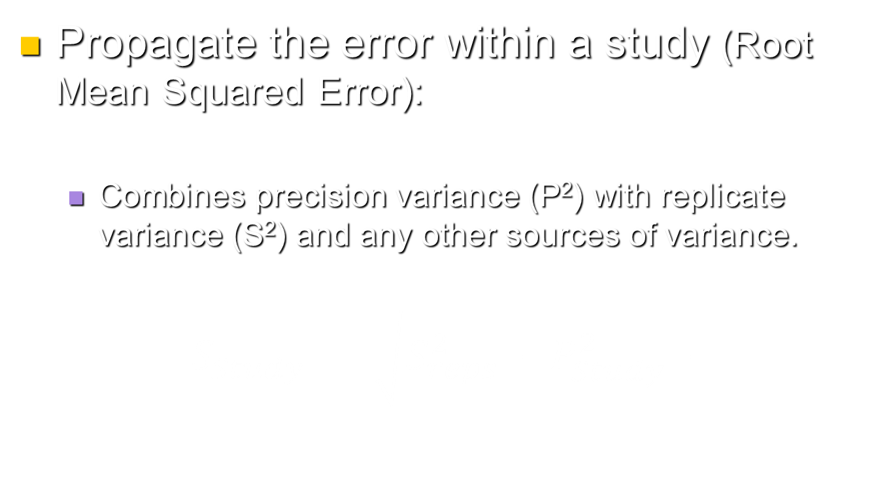
Propagating Uncertainty
Propagate the error within a study (Root Mean Squared Error):
Combines precision variance (P²) with replicate variance (S²) and any other sources of variance.
$$S_{Study}= \sqrt{S_{reps}^{2}+P_{Study}^{2}+}$$

Slide 13
Break Questions:
For your study, answer the following:
What is an appropriate replicate sample?
What is an appropriate field duplicate?
What is an appropriate lab duplicate?
We will calculate E_{report} in exercise.

Slide 14
Sources of Error
IRMS Analysis Error
Systematic error
Non-linearity over range of machine voltages – sample size.
Instrument drift – time related shifts - ion source degradation, GC column changes, temperature changes in lab.
Random error
Machine sensitivity (peak shapes, tailing, etc.)
Maintenance issues.
Calibration error
1 point vs. multipoint calibration
Not following Identical Treatment Principle
Mishandling of standards
Sample error
Homogenization of samples
1 mg of a 10 g sample – grind to powder!!
Fractionation due to sample processing

Slide 15
Calibration and Isotopic Standards
Standard Uses:
Correct for IRMS drift, gas volume differences.
Calibration to international isotope ratio scale (i.e. VSMOW, VPDB).
Quality Control Sample – Calculating Accuracy.
Identical Treatment Principle
samples and reference standards treated the same (i.e. combustion, equilibration etc.)
Levels of standards:
Scale-defining International Certified Standards (VSMOW, VPDB etc).
International Certified Standards
Internal Laboratory Working Standards
Study Standards

Slide 16
From IRMS to you: data correction issues
Data correction steps:
Volume normalization (gas volume issues)
Drift (temperature, pressure, humidity changes over run time).
Calibration scale adjustment to international isotope scale.
Calibration standards should covering relevant δ scale (two or three points at least).
Calibration and QA standards must be treated the same as samples (Identical Treatment Principle).
Must have standard not used to calibrate for QC to calculate accuracy.

Slide 17
Volume Normalization

Slide 18
Apply Corrections

Slide 19
Drift Correction

Slide 20
Fit curve to the data

Slide 21
Apply Correction

Slide 22
Calibration to International Scale
Calibration Standards
QC Standard

Slide 23
Break Questions:
Why is the Identical Treatment Principle important?
How might you apply it in your study?
Questions about
Data Correction?
Calibration?
Quantifying accuracy of the data?

Slide 24
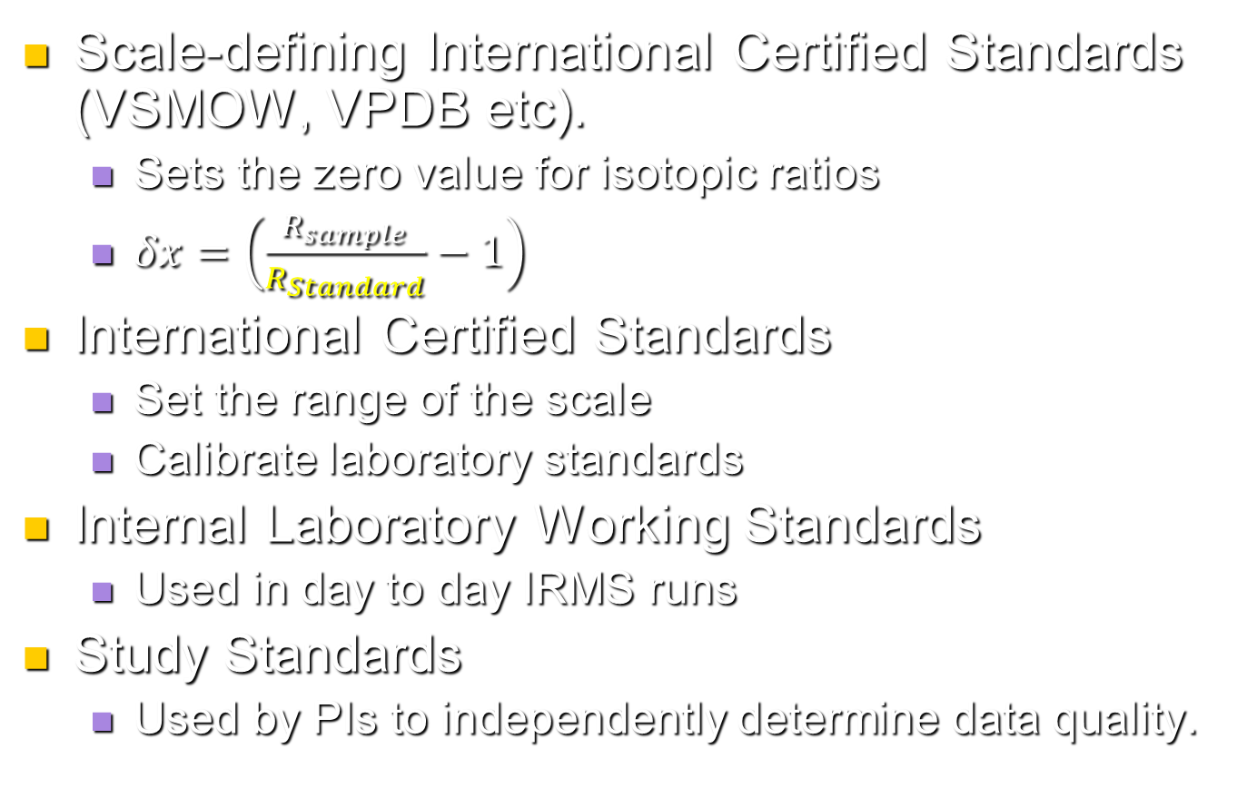
Types of Isotopic Standards
Scale-defining International Certified Standards (VSMOW, VPDB etc).
Sets the zero value for isotopic ratios
$δx=\left(\frac{R_{sample}}{R_{Standard}}−1\right)$
International Certified Standards
Set the range of the scale
Calibrate laboratory standards
Internal Laboratory Working Standards
Used in day to day IRMS runs
Study Standards
Used by PIs to independently determine data quality.

Slide 25
International Certified Standards
For calibrating IRMS and IRMS lab standards to international isotope ratio scales (i.e. VPDB etc).
Certified by:
IAEA: International Atomic Energy Agency
NIST: National Institute of Standards and Technology
Expensive and limited availability
Don’t exist for many biological materials of interest.
Considerable time to produce and certify new standards.

Slide 26
δ¹³C International Certified Standards (excluding carbon gas standards)
Ref. Material | Substance | δ¹³C | Reference
NBS 18 | CaCO₃ | -5.06 ± 0.06 | Stichler 1995
NBS 19 (VPDB) | CaCO₃ | +1.95 exactly | Hut, 1987
IAEA-CO-1 | CaCO₃ | +2.48 ± 0.03 | Stichler 1995
IAEA-CO-8 | CaCO₃ | -5.75 ± 0.06 | Stichler 1995
L-SVEC | Li₂CO₃ | -14.48 ± 0.15 | Stichler 1995
IAEA-CO-9 | BaCO₃ | -47.12 ± 0.15 | Stichler 1995
USGS24 | C (graphite) | -15.99 ± 0.11 | Stichler 1995
NBS 22 | Oil | -29.75 ± 0.12 | Gonfiantini et al. 1995
IAEA-C-6 | Sucrose | -10.43 ± 0.13 | Gonfiantini et al. 1995
Coplen et al. 2002 USGS Water-Resources Investigations Report 01-4222

Slide 27
Laboratory Working Standards
Standards used in daily IRMS operations.
Isotopically stable material available in large quantities.
Calibrated to the International Certified Standards.
Isotopically homogenous
Similar matrix to the samples being processed (leaf tissue, water, muscle tissue, etc.)
Should span the isotopic range of samples.
Difficult to find material to meet all objectives.

Slide 28
ISIRF δ¹³C Laboratory Standards
Ref. Material | δ¹³C
NIST PINE NEEDLES | -26.23
NIST SPINACH | -26.73
NIST TOMATO LEAVES | -27.01
NIST OYSTER TISSUE | -22.00
NIST PEACH LEAVES | -26.15
NIST APPLE LEAVES | -27.08
NIST CORN STALK | -11.58
NIST RICE FLOUR | -25.98
NIST CITRUS LEAVES | -27.50
NIST BOVINE LIVER | -22.46
NIST LADY BUG TISSUE | -26.04
ISIRF CELLULOSE | -24.76
NIST SOIL SO-4 | -25.69
NIST SOIL SO-2 | -24.96
NIST BUFFALO RIV. SED. | -19.90
NIST SOIL 2710 | -24.93
NIST SOIL 2711 | -17.09
NIST SOIL SO-3 | 1.78
Two point Calibration:
NBS 22 (oil)
IAEA-C-6 Sucrose.
QC: USGS24 Graphite
NOTE: These are NIST % C Concentration Standard, Isotope values not certified by NIST.

Slide 29
ISIRF Standard Isospace

Slide 30
Study Standards
Use to independently calculate study precision.
Create a large homogenous sample of similar matrix to your study samples.
Place one at the beginning and end of each sample run.
Examine fractionation issues with sample processing.
Use sample with known isotopic value (lab standard)
Follow identical treatment principle - process as you would a sample to detect sample prep and analysis errors.
If fractionation can not be eliminated, systematic fractionation can be corrected.
Porter, T. J. and P. Middlestead. 2012. On estimating the precision of stable isotope ratios in processed tree-rings. Dendrochronologia in press.

Slide 31
Break Questions:
Can you think of a good study standard for your work?
Other Questions?

Slide 32
Selecting a good lab: How good is their QA?
Ask for the standard deviation on the lab QC standards over the last several months.
Ask about their QA and calibration procedures
How do they deal with linearity or machine drift problems?
How do they calibrate to the international scale – one point, or multipoint calibration?
How many standards and replicates do they run? More variable the process the more standards and reps should be run.
Find other people who have run samples at that lab and ask their opinion.
Ask that all standard and replicate data be given to you so you can calculate accuracy and precision for your study samples.

Slide 33
IAEA 2011 Water Isotope Interlaboratory Comparison
ISIRF

Slide 34
IAEA 2016 Water Isotope Interlaboratory Comparison
ISIRF

Slide 35
IAEA 2016 Water Isotope Interlaboratory Comparison
Wassenaar et al. 2018 RCM.

Slide 36
Laboratory Problems (Survey of 66 unacceptable labs)
Incorrect data normalization 33 %
Insufficient lab std. d-scale coverage 32 %
Instrumental Problems 31 %
Problem not yet identified 23 %
Compromised Laboratory Standards 15 %
Participate in Interlaboratory Comparisons!
Identify Problems
Improve QAQC
Wassenaar et al. 2018 RCM.

Slide 37
Laboratory Precision (EA): repeated measures over time

Slide 38
Switching labs within a study?

Slide 39
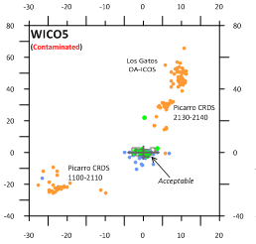
Problems with IRIS technology and organic contaminants
Los Gatos
OA-ICOS
Picarro CRDS
2130-2140
Picarro CRDS
1100-2110
Acceptable
Wassenaar et al. 2018 RCM.

Slide 40
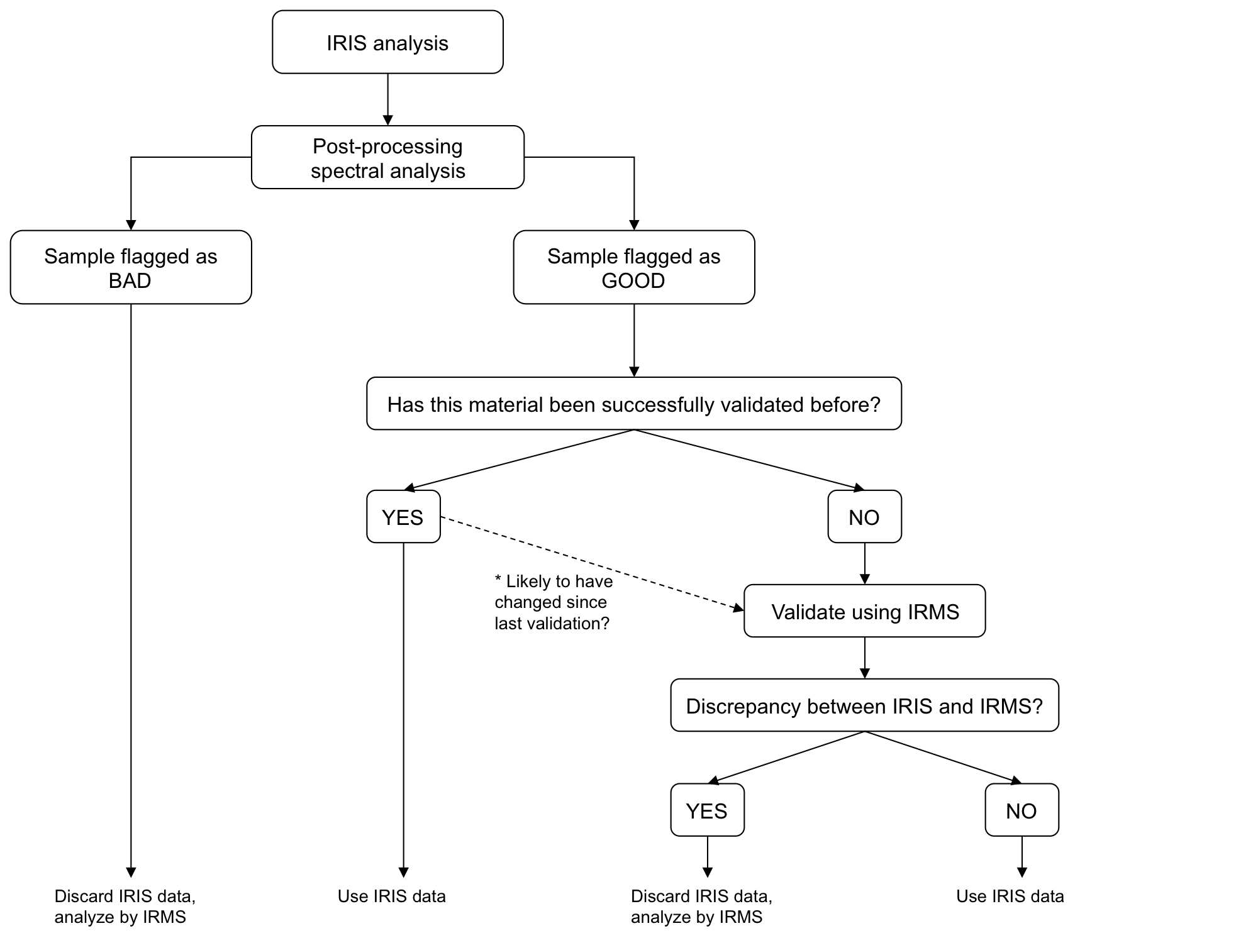
Plant Water: IRIS or IRMS?
West et al RCM 2011

Slide 41
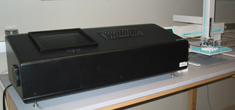
Setting up a Laser Absorption Spectrometer for water?
Wassenaar, L., T. B. Coplen, and P. Aggarwal. 2014. Approaches for achieving long-term accuracy and precision of δ¹⁸O and δ²H for waters analyzed using laser absorption spectrometers. Environmental Science and Technology 48: 1123-1131.

Slide 42
Quality Assurance in your Study Sampling Design
Consider potential sources of variation and the variation you are interested in.
Source Variation.
Process Variation.
Temporal and Spatial Variation in both
Collect a representative sample or bulk several samples that average variation.
Collect samples that either avoid or account for other potential sources of variation.
Collect field duplicates 1 out of 10-20 samples.
Cost issues – Error on collecting more samples than you can analyze.

Slide 43
Sample Error
Test your processing protocols for fractionation!
Calculate precision and accuracy from your own data (your duplicates and lab standards).
For outside analysis: Use your own study standard
Measure your study standard every 60-100 samples.
Do blind duplication within a run, in addition to ones recommended by the lab (Field duplicates).
Run a set of samples a couple of times.
Be sure your samples are ground finely – Homogenization. (1 mg from a 10 g sample)
Be consistent in sample size so that your samples create a voltage between 3 and 5 volts. Avoid IRMS linearity problems
Label samples with easy to understand codes (C2016-1, C2016-2,…C2016-100 etc). Keep samples in order.

Slide 44
Visual QA/QC
Look at your data carefully and immediately!
Graph it!
Are the patterns expected relative to theory?
Have odd samples rerun.
Calculate the accuracy, precision, and signal to noise ratios for your study results.
Are your treatment differences greater than your precision?

Slide 45
QA/QC should answer the following questions:
How well is the machine running, including the calibration process?
How variable are my samples (variation within a sample)?
Have my samples been unintentionally fractionated since collection?
How variable are my populations of interest?
Can I tell the difference between populations that I would like to?

Slide 46
QA/QC Exercise
Calculating QA/QC metrics from all the QAQC data generated in a study (multiple runs from the IRMS).
Open “QAQC Exercise 2019.xls”
Refer to the handout to calculate accuracy and precision.

